Slide 1
Pilot Data
2/15/24

Slide 2


Task Diagram (BLOCKED and INTERMIXED blocks)
Recognition Trial
SOA: 400-500 ms
100 ms
900 ms
Response (3000 ms)
SOA: 400-500 ms
100 ms
900 ms
Response
Recall
Trial
Notes:
Blocks of 25; mix recognition and recall trial blocks (smaller)
Plot as function of K?? Not sure why???

Slide 3
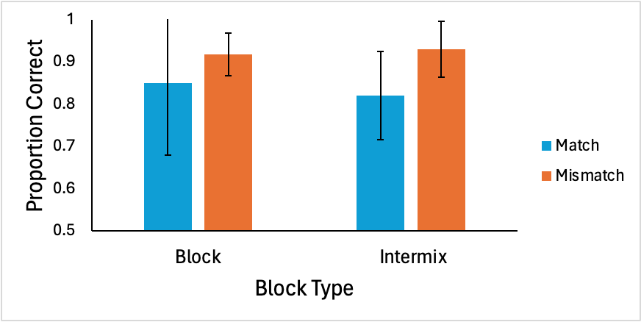
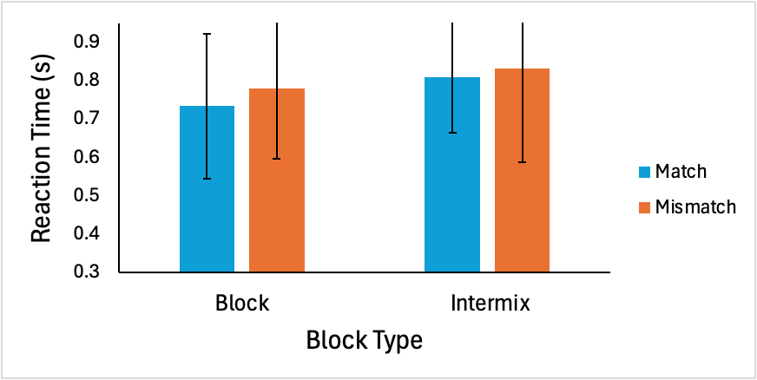
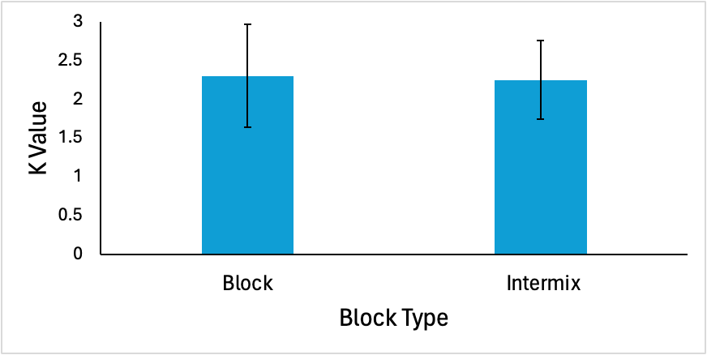
Recognition Data (N = 3)
Error bars represent 95% CI

Slide 4
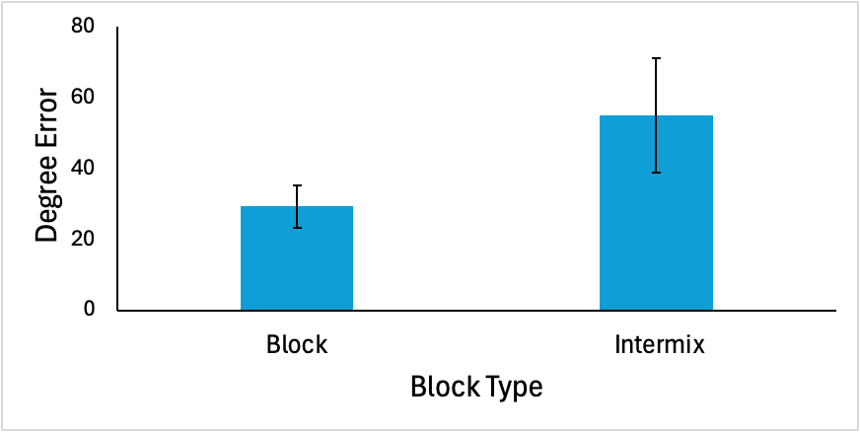
Recall Data (N = 3)
Error bars represent 95% CI

